Slide 1

plagiarism tutorial
Oxford high school library
Amanda Osborne, librarian

Slide 2
Welcome!
This tutorial will help you avoid plagiarism!
Many examples, showing how to properly cite information from other sources in your work, are included in the tutorial.
As you make your way through the tutorial, there will be two quizzes that help you understand the difference between an acceptable use of a source and plagiarism. Take a guess! Click on the answer you think best. If you choose an incorrect answer simply try the other option; no matter which answer you choose, there will be an explanation as to why the example is or is not plagiarism.
The Resources page offers suggestions on note-taking to keep yourself organized and track your sources. You will also find links to pages with in-depth information on internal citation styles and the Oxford School District Code of Conduct section on Academic Dishonesty.
OSD’s Academic Dishonesty Definition: Using or submitting work that is not your own, also known as cheating, plagiarism, copying, transferring computer files, etc. Students will be expected to follow classroom instructions relating to academic integrity.
When you have completed the tutorial, “Test Your Knowledge” to see what you learned.
What is Plagiarism?
This tutorial was adapted from The University of Southern Mississippi’s Plagiarism Tutorial.

Slide 3
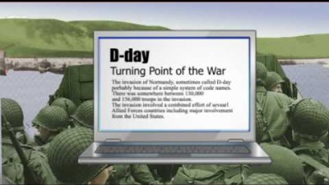
What is plagiarism?
Plagiarism is the act of taking another person's writing, conversation, song, or even idea and passing it off as your own. This includes information from web pages, books, songs, television shows, email messages, interviews, articles, artworks or any other medium.
When someone gets in trouble for plagiarism, it usually means they copied exact sentences or almost-exact sentences from someone else without including quotation marks or indicating that the words were not their own. Plagiarism also involves turning in papers that are purchased from websites. Paying someone to write your paper or getting your family/friends to write the paper for you is plagiarism. Basically, using any other method outside of composing the work yourself is plagiarism.
More About Plagiarism

Slide 4
More about plagiarism
What if the Information is something everybody knows?
There are instances when credit is not necessary. If you include information that is generally considered common knowledge, you do not need to cite a source. The common knowledge exception usually includes things like dates, facts, names and other information easily found in general reference books (encyclopedias).
For example, the United States was founded in 1776, has 50 states, and sent astronauts to the moon in 1969. Common knowledge exceptions may also apply within a particular group and therefore depends on the expected audience of readers. When in doubt, go ahead and cite the information.
Is it possible to plagiarize yourself?
Yes! Copying and pasting or rewriting the same text from one of your paper’s to another is still considered plagiarism. You may quote or paraphrase yourself according to the same guidelines as using the work of another author.
How do I avoid plagiarism?
To avoid plagiarism, always inform your audience of any ideas or words that are not your own.
The MLA Style Guide explains how to cite your sources.
In-Text Citations

Slide 5
In-text citations
An in-text citation refers to the practice of giving credit to an author, singer, or speaker by citing their words/ideas within the text of your paper. This in-text citation is then referenced in a list at the end of the paper called a Works Cited page.
In-text citations are sometimes called parenthetical citations because they’re enclosed by parentheses. You may read an article where every other sentence seems to have something like (Armstrong 11) at the end. The writer of the article is telling the reader the name of the person responsible for the information in the preceding sentence and on what page of the author's work this information is located. In this example of MLA style, the author is Armstrong and the page number is eleven. The reader will find the full title of the work on the Works Cited page if he or she wants to track down the original article, book, interview, song, etc. by Armstrong.
  EXAMPLE: All roads lead to Rome (Armstrong 11).
Another way to formulate an in-text citation is to mention the name of the author in the sentence itself. In MLA style, the page number would be in the parenthesis at the end of the sentence without the name.
EXAMPLE: As Armstrong explains, some school programs work better than others (11).
In-Text Citation Style Guide
Works Cited Page

Slide 6
Works Cited Page
The list of sources at the end of an MLA paper is called the Works Cited page.
MLA Works Cited Page - Basic Format
The entries on the Works Cited page include all of the sources (books, articles, Internet sites, etc.) you’ve quoted, paraphrased, or used to create your paper.
Each entry is listed in alphabetical order by the author’s last name. This way, readers may learn where you found the information.
Example - if you quoted a line from a scholarly journal article called ”Executive on a Mission: Saving the Planet” by Cornelia Dean, then the citation information (author, title of work, publication information, year, etc.) about ”Executive on a Mission: Saving the Planet” will be listed in your Works Cited page under Dean, Cornelia.
Sample Works Cited Page

Slide 7
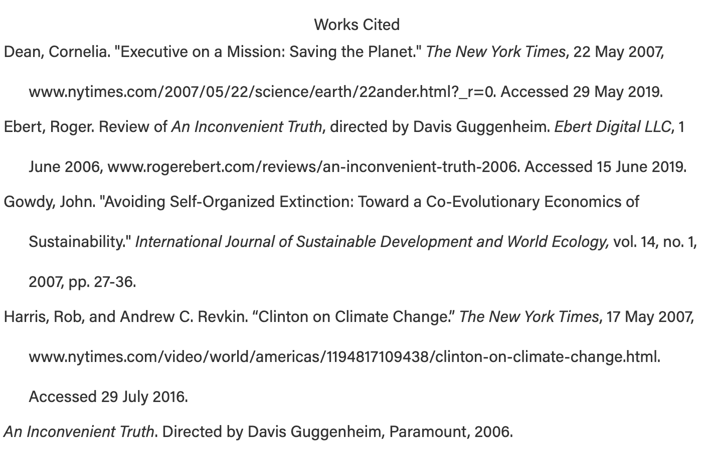
Formatting Entries

Slide 8
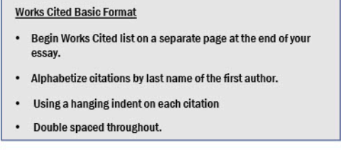
Formatting Entries
On the Works Cited page, citations for different types of sources are uniquely formatted .
  Book
  Periodicals (magazines, newspapers, scholarly articles)
  Electronic Sources (databases, e-books, websites, online images, YouTube Video)
  Other Common Sources
Common Knowledge

Slide 9
What is Common Knowledge?
Common knowledge needs no internal citation in a paper. Common knowledge includes information that is considered a well-established fact verifiable in five or more sources. It also includes common sayings and proverbs ("look before you leap") and historical dates, places, and events.
An example of common knowledge needing no citation: The English Renaissance took place in 1448-1605.
Unique Phrases

Slide 10
What is a unique phrase?
A unique phrase does need an internal citation. A unique phrase is one which is coined by an author and used commonly by other authors in a specific genre or discipline, but it is not necessarily a common fact or phrase used by everyone.
An example of unique phrase needing a citation: Fran Lebowitz, “In real life, I assure you there is no such thing as Algebra” (5).
Quoting

Slide 11
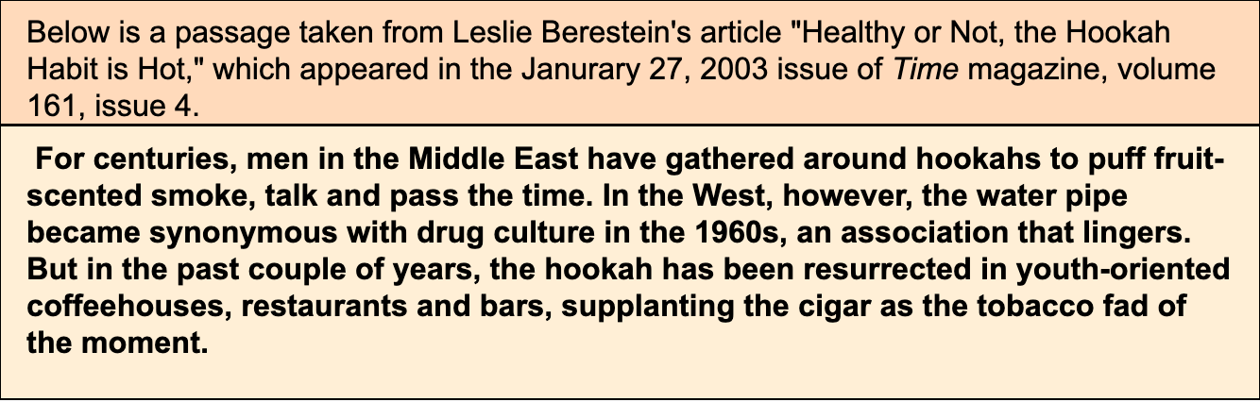
How to Avoid Plagiarism: Quoting
Quoting involves using exact words, phrases and sentences from a source, setting them off with quotation marks, and citing where the information was taken from.
In the following examples, notice that the writer quotes Berestein's words exactly as it was given within the sentence from the original source. Whenever you quote someone else's words, you have to write them exactly as they originally appear.
Quoting Example #1

Slide 12
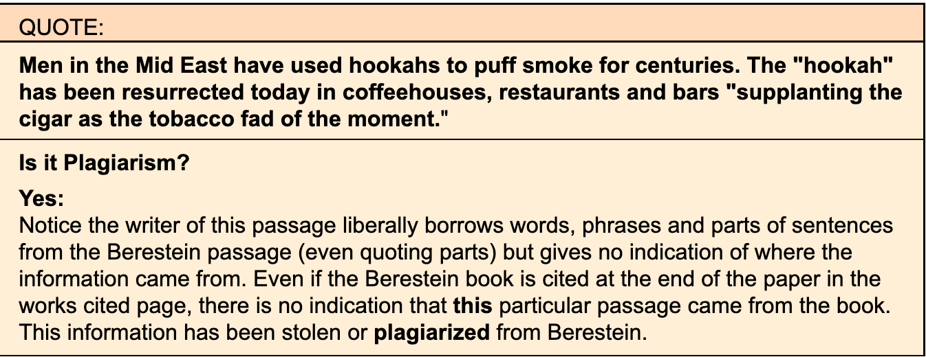
Quoting example #1
Quoting Example #2

Slide 13
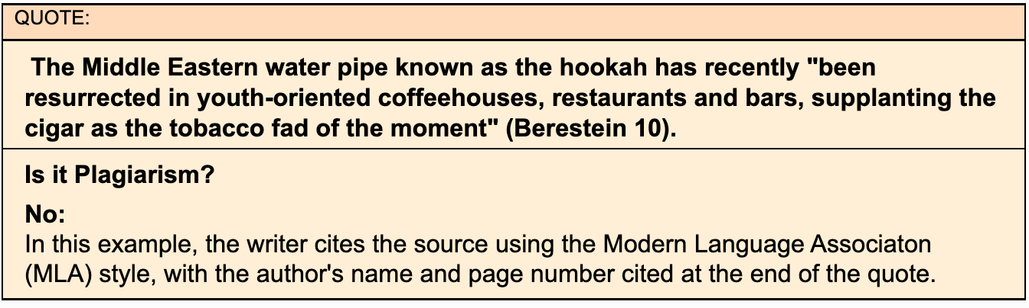
Quoting example #2
Quiz #1

Slide 14
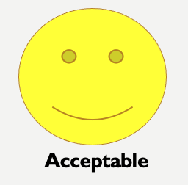
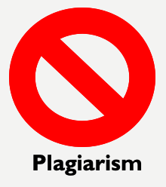
Acceptable or Plagiarism?
Quiz #1
In each example that follows, the paragraph on the left is text taken from a scholarly journal.
On the right is an examples of how the information has been used by a student.
For each different use, indicate whether you think the use is acceptable (properly cited) or constitutes plagiarism.
Example #1

Slide 15
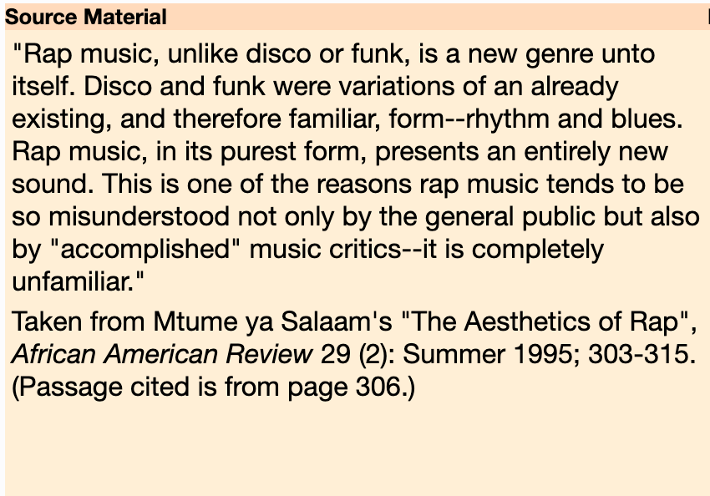
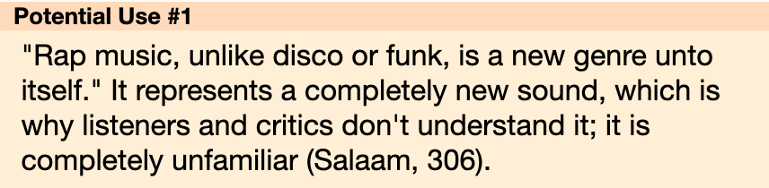
Example #1
Acceptable
Plagiarism
Acceptable

Slide 16

Acceptable
Incorrect. This is not acceptable use.
It would be considered plagiarism because the first sentence quotes the source, yet does not cite the author or the page number. The second sentence by itself is a good example of a direct quotation, but the writer needs to cite the first sentence as well - maybe by starting the sentence off with ’Mtume ya Salaam believes...’ and ending with the page number from the article.
Plagiarism

Slide 17

Plagiarism
CORRECT.
The first sentence quotes the source material, yet does not cite the author or the page number. The second sentence by itself is a good example of a direct quotation, but the writer needs to cite the first sentence as well - maybe by starting the sentence off with ’Mtume ya Salaam believes...’ and ending with the page number from the article.
Example #2

Slide 18
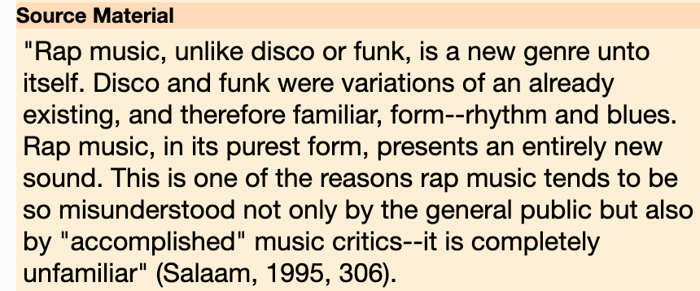
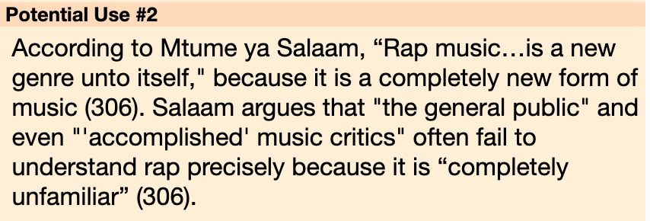
Example #2
Acceptable
Plagiarism
Acceptable

Slide 19
Acceptable
CORRECT!
The entire sentence indicates Salaam’s ideas about rap music by enclosing the borrowed material completely. The sentence starts with his name, uses a direct quotation set off with quotation marks, and ends with a direct quotation and page number that shows where the writer found these ideas.
Plagiarism

Slide 20
Plagiarism
Incorrect. This would be considered acceptable use.
The entire sentence indicates Salaam’s ideas about rap music by enclosing the borrowed material completely. The sentence starts with his name, uses a direct quotation set off with quotation marks, and ends with a direct quotation and page number that shows where the writer found these ideas.
Example #3

Slide 21
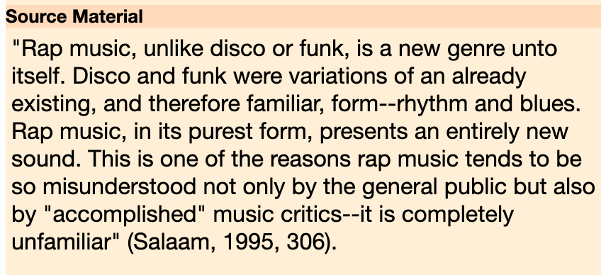
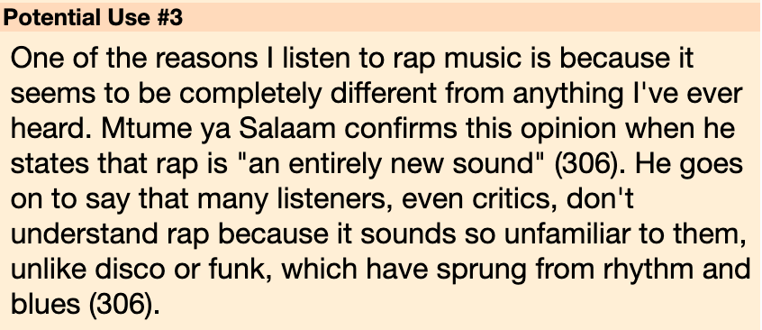
Example #3
Acceptable
Plagiarism
Acceptable

Slide 22
Acceptable
CORRECT!
As with Example #2, the writer has enclosed all the borrowed material with proper citation--the author’s name, quotation marks and a page number. The second sentence, which is a paraphrase of Salaam’s material, also uses proper citation. Notice, too, how the writer begins with her opinion and supports it with Salaam’s words. This is acceptable, because she is careful to distinguish her opinion (that rap music is completely different) from Salaam’s material.
Plagiarism

Slide 23
Plagiarism
Incorrect. This is an acceptable use of the quotation.
As with Example #2, the writer has enclosed all the borrowed material with proper citation--the author’s name, quotation marks and a page number. The second sentence, which is a paraphrase of Salaam’s material, also uses proper citation. Notice, too, how the writer begins with her opinion and supports it with Salaam’s words. This is acceptable, because she is careful to distinguish her opinion (that rap music is completely different) from Salaam’s material.
Block Quotes

Slide 24
Block Quotes (long quotes)
Block Quotes are used when a quote is more than four lines of prose or three lines of verse
Block Quote Formatting Rules:
  Place quotations in a free-standing block of text and omit quotation marks.
  Start the quotation on a new line, with the entire quote indented 1/2 inch from the left margin while maintaining double-spacing.
  Your in-text citation should come after the closing punctuation mark.
  When quoting verse, maintain original line breaks. (You should maintain double-spacing throughout your essay.)
Block Quote Examples

Slide 25
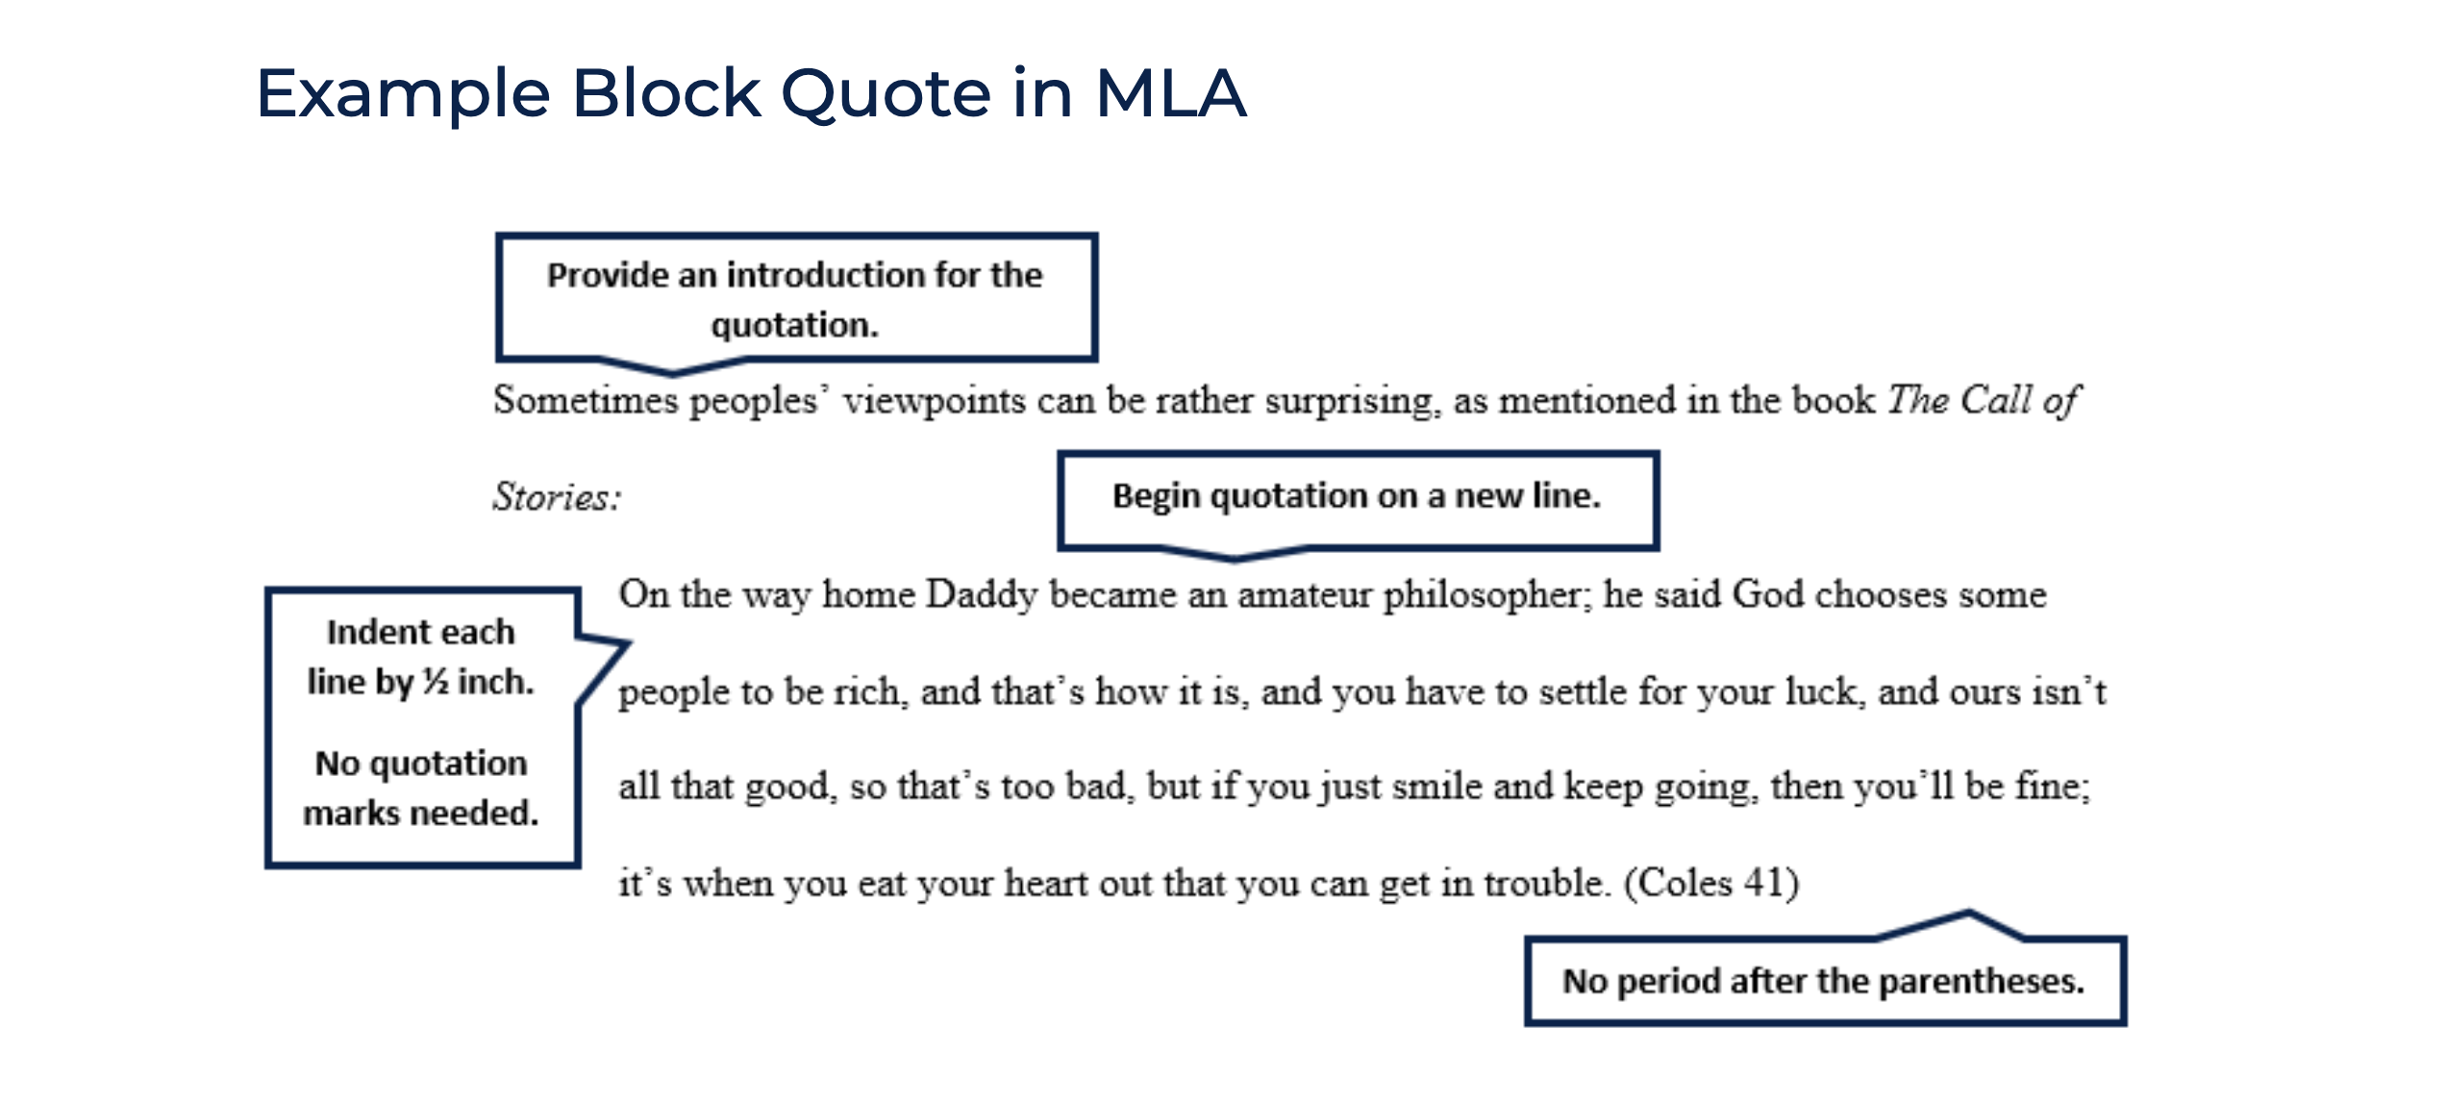
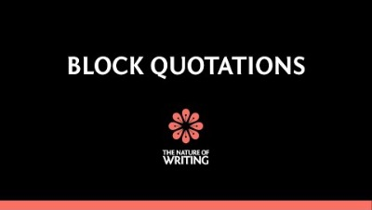
Block Quote Examples
https://writingcenter.uagc.edu/block-quotations
Paraphrasing & Summarizing

Slide 26
How to Avoid Plagiarism: Paraphrasing and Summarizing
Paraphrasing and summarizing are very similar.
Both involve taking ideas, words or phrases from a source and crafting them into new sentences within your writing.
Paraphrasing is when you write restatement of the information you have gathered from a source. By paraphrasing, you are able to provide supporting information without using a quote. Although paraphrases are in your own words, you do need to provide an in-text citation to show that information was originally from another author. Remember a paraphrase needs to be in your own words, writing style, and you need to provide an in-text citation.
Summarizing involves putting the main idea(s) into your own words, including only the main point(s). It is necessary to cite summarized ideas. Summaries are shorter than the original and condense the source information.
Whether paraphrasing or summarizing, credit is always given to the author.
Paraphrasing & Summarizing Example

Slide 27
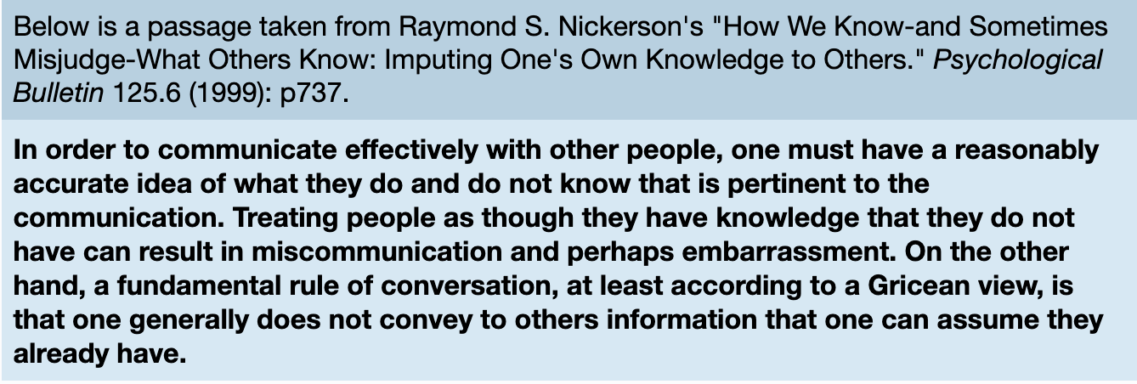
Paraphrasing and Summarizing Example
Original Source
Plagiarism?

Slide 28
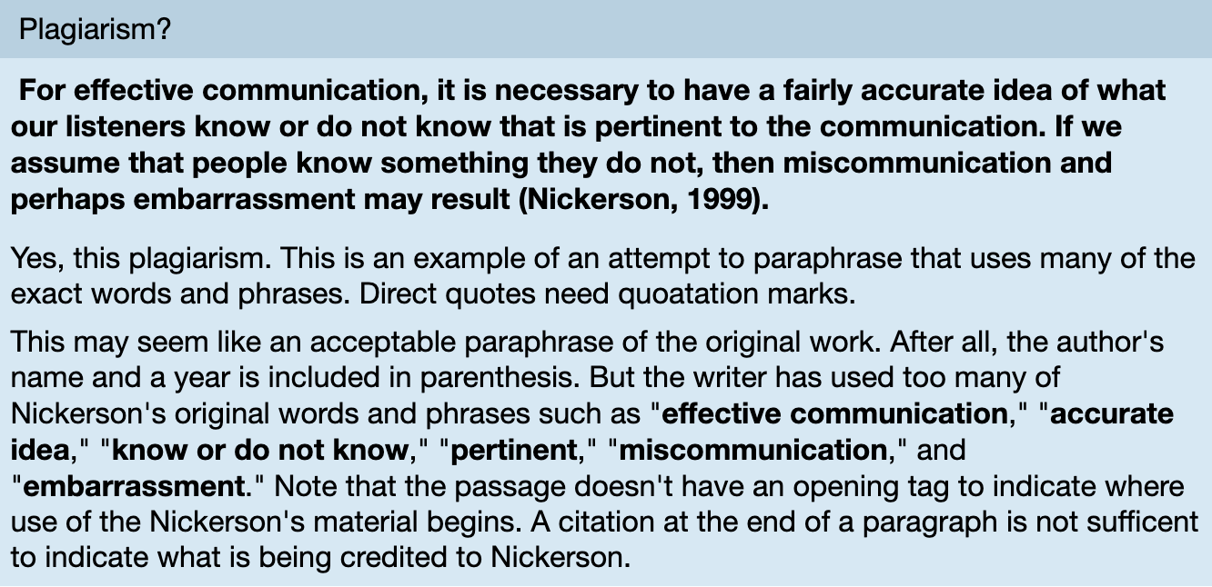
Plagiarism of source?
Proper Paraphrase Example

Slide 29
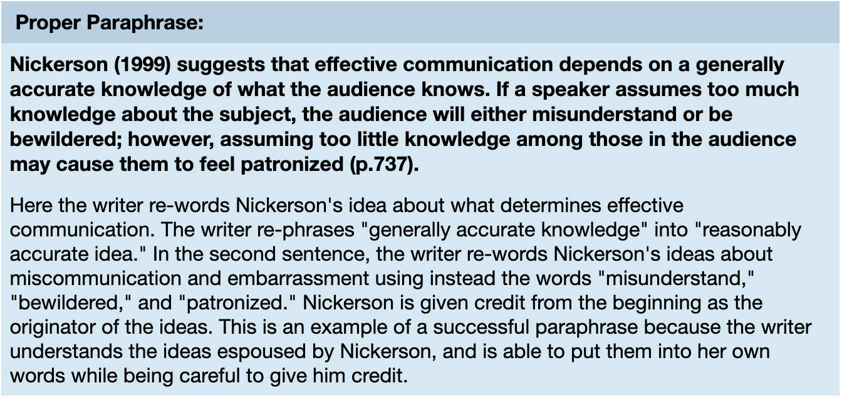
Proper paraphrase of source
Proper Summary Example

Slide 30
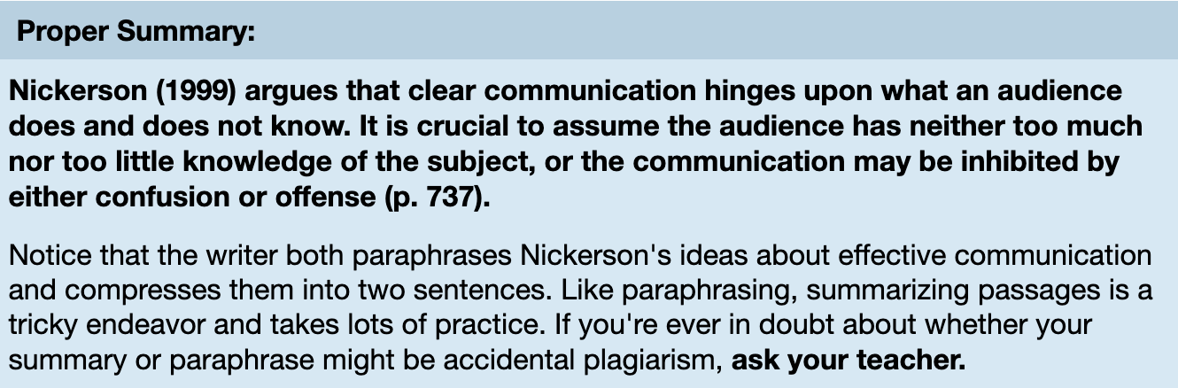
Proper summary of source
Quiz 2

Slide 31
Acceptable or Plagiarism?
Quiz #2
In each example that follows, the paragraph on the left is text taken from a scholarly journal.
On the right is an examples of how the information has been used by a student.
For each different use, indicate whether you think the use is acceptable (properly cited) or constitutes plagiarism.
Example #1

Slide 32
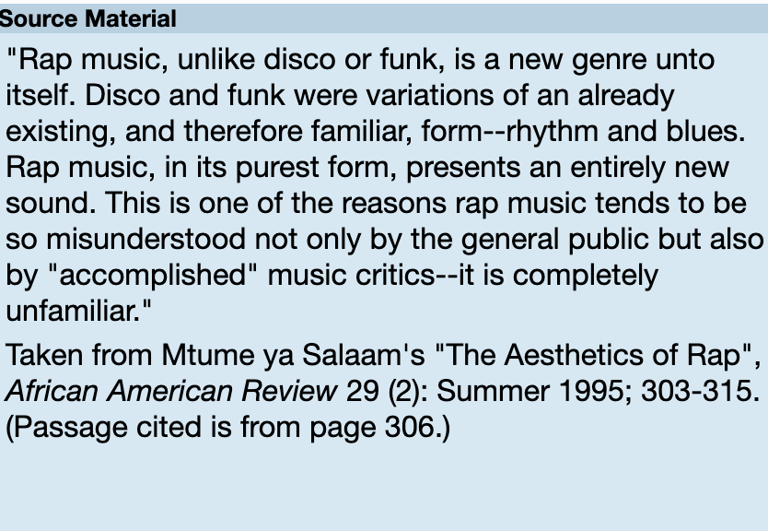
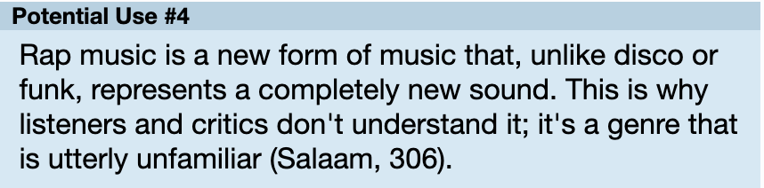
Example #1
Acceptable
Plagiarism
Acceptable

Slide 33
Acceptable
Incorrect. This is not acceptable use.
It would be considered plagiarism because the first sentence quotes the source, yet does not cite the author or the page number.
The second sentence by itself is a good example of a direct quotation, but the writer needs to cite the first sentence as well - maybe by starting the sentence off with ’Mtume ya Salaam believes...’ and ending with the page number from the article.
For MLA examples about how to start quotes, read “Signal and Lead-In Phrases.”
Plagiarism

Slide 34
Plagiarism
CORRECT!
The first sentence quotes the source material, yet does not cite the author or the page number.
The second sentence by itself is a good example of a direct quotation, but the writer needs to cite the first sentence as well - maybe by starting the sentence off with ’Mtume ya Salaam believes...’ and ending with the page number from the article.
For MLA examples about how to start quotes, read “Signal and Lead-In Phrases.”
Example #2

Slide 35
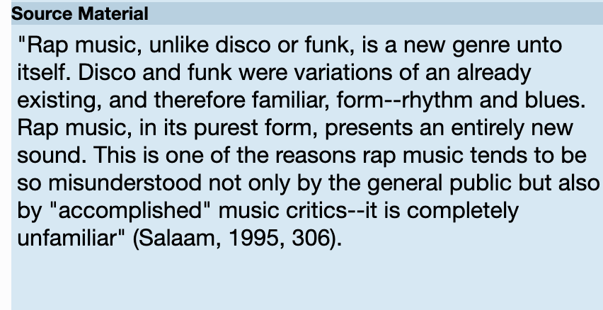
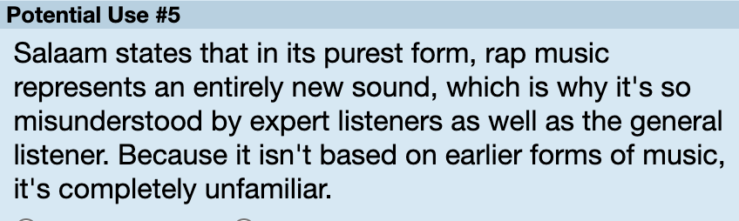
Example #2
Acceptable
Plagiarism
Acceptable

Slide 36
Acceptable
Incorrect. This is not acceptable use.
This would be considered plagiarism, because although the writer credits Salaam in the first sentence, there is no indication where (on what page) this paraphrase came from, and the writer lifts a quotation directly from the source material without quoting it.
Notice, too, that there is no citation of any kind in the second sentence, which the writer needed to provide because it is a close paraphrase of Salaam’s sentence.
Plagiarism

Slide 37
Plagiarism
CORRECT!
This would be considered plagiarism, because although the writer credits Salaam in the first sentence, there is no indication where (on what page) this paraphrase came from, and the writer lifts a quotation directly from the source material without quoting it.
Notice, too, that there is no citation of any kind in the second sentence, which the writer needed to provide because it is a close paraphrase of Salaam’s sentence.
Example #3

Slide 38
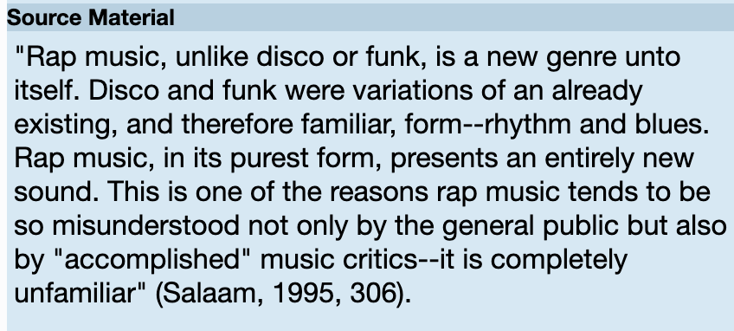
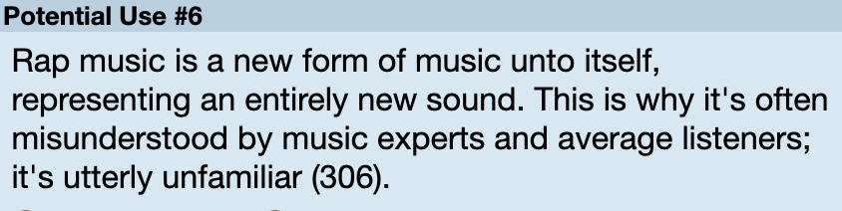
Example #3
Acceptable
Plagiarism
Acceptable

Slide 39
Acceptable
Incorrect. This is not acceptable use.
Again, even though the writer provides a citation at the end of the second sentence, that citation is incomplete (who is the writer citing?), and this citation does not tell us where the borrowed material begins.
Plagiarism

Slide 40
Plagiarism
CORRECT!
Even though the writer provides a citation at the end of the second sentence, that citation is incomplete (who is the writer citing?), and this citation does not tell us where the borrowed material begins.
Suggestions for Note Taking To Avoid Plagiarism

Slide 41
Suggestions for Note-taking to avoid plagiarism
Write down the citation of your sources. For each source you use, keep track of the bibliographic data--for a journal article, it's the author, article title, journal title, volume and page numbers. For a book, it's the author, title, publication place and date. For an Internet site, it's the author, the title of the web page (if any), the sponsoring organization, the web site address, the date it was last updated, and the date you last looked at it. One handy tip: once you've printed out the article or web site, or copied part of the book, write the complete citation (author, title, etc.) directly on your copy. That way you'll have it once you're ready to do your works cited page.
Take careful notes. Distinguish sentences/passages you're quoting directly with *big* quotation marks, or by color- coding them with a highlighter. Be sure to note who you're quoting. And when paraphrasing, highlight or mark those passages to distinguish them from your own ideas--which you can mark by writing or typing the word "ME" next to them.
Keep a research log. On a separate sheet of paper or in a separate document, note the different databases/catalogs/search engines you use when doing research, as well as the combination of terms you use for each source. This will come in handy when you're trying to remember what database you found that perfect article in, and will also come to your defense if you're ever unjustly accused of plagiarism.
Don't toss your notes till the semester is over. You never know when you'll need to look back at something, or (worst case scenario) provide proof that you didn't plagiarize.
Plagiarism Recap
(taken from Fairfield University's Dimenna Nyselius Library "Note Taking Tips "):

Slide 42
Plagiarism Re-Cap
When you use anyone else's words or ideas in your own work, you MUST give the creator credit and provide a citation.
Whenever you paraphrase, summarize, or quote another person's work, it is NECESSARY to indicate the source of the information using an in-text citation.
It is not enough to just list the source in Works Cited page at the end of your paper.
Failing to properly quote, cite, or acknowledge someone else's words or ideas is plagiarism.
Test Your Knowledge

Slide 43


Test Your Knowledge
Question #1
1. Copying and pasting from the Internet can be done without citing the Internet page, because everything on the Internet is common knowledge and can be used without citation.
FALSE
TRUE
True

Slide 44
True
The correct answer is False.
Web pages and other Internet sources are created by an author or authors, which means that if you use something from the Internet, you have to cite it.
For citation examples of Internet or Web Sources including entire websites, web pages, and other online content, visit the following link:
  MLA Works Cited: Electronic Sources (Web Publications)
False

Slide 45
false
CORRECT
Web pages and other Internet sources are created by an author or authors, which means that if you use something from the Internet, you have to cite it.
For citation examples of Internet or Web Sources including entire websites, web pages, and other online content, visit the following link:
  MLA Works Cited: Electronic Sources (Web Publications)
Question #2

Slide 46
Test Your Knowledge
Question #2
2. You don’t have to use quotation marks when you quote an author as long as you cite the author’s name at the end of the paragraph.
FALSE
TRUE
True

Slide 47
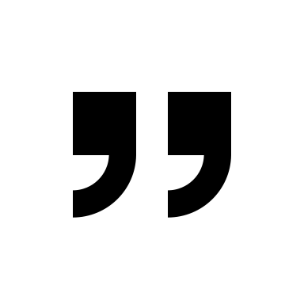
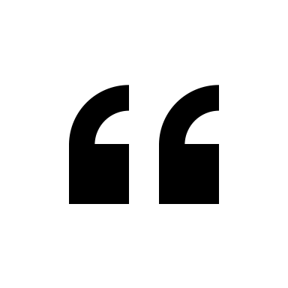
True
The correct answer is False
Whenever you quote someone else's words you have to designate what they say by using quotation marks to show that you've borrowed it and to set it apart from your own writing.
For more information on using quotes correctly, visit the following link:
  MLA Formatting: Quotations
False

Slide 48
false
Correct
Whenever you quote someone else's words you have to designate what they say by using quotation marks to show that you've borrowed it and to set it apart from your own writing.
For more information on using quotes correctly, visit the following link:
  MLA Formatting: Quotations
Question #3

Slide 49
Test Your Knowledge
Question #3
3. When you summarize a block of text from another work, citing the source at the end of your paper is sufficient.
FALSE
TRUE
True

Slide 50
True
The correct answer is False.
When you summarize a block of text, you have to cite the source within your paper.
To learn more about summarizing, visit the following link:
  Quoting, Paraphrasing, and Summarizing
False

Slide 51
false
Correct
When you summarize a block of text, you have to cite the source within your paper.
To learn more about summarizing, visit the following link:
  Quoting, Paraphrasing, and Summarizing
Question #4

Slide 52
Test Your Knowledge
Question #4
4. If you paraphrase another person’s ideas, you don’t have to cite him/her/they OR use quotation marks because you put the ideas into your own words.
FALSE
TRUE
True

Slide 53
True
The correct answer is False.
When you put someone else’s ideas into your own words, you have paraphrased the ideas. If you paraphrase someone else’s ideas without including a citation, you are plagiarizing.
For more information about paraphrasing, visit the following link:
  Paraphrase: Write It In Your Own Words
False

Slide 54
false
Correct
When you put someone else’s ideas into your own words, you have paraphrased the ideas. If you paraphrase someone else’s ideas without including a citation, you are plagiarizing.
For more information about paraphrasing, visit the following link:
  Paraphrase: Write It In Your Own Words
Question #5

Slide 55
Test Your Knowledge
Question #5
5. You don't have to cite famous dates because they’re common knowledge.
FALSE
TRUE
True

Slide 56
True
CORRECT!
When you are using "common knowledge," things that do not need a citation are common sayings and proverbs ("look before you leap") and historical dates, places, and events.
For more information on “common knowledge”, visit the following link:
  What is ‘Common Knowledge’?
False

Slide 57
false
The correct answer is True.
When you are using "common knowledge," things that do not need a citation are common sayings and proverbs ("look before you leap") and historical dates, places, and events.
For more information on “common knowledge”, visit the following link:
  What is ‘Common Knowledge’?
Question #6

Slide 58
Test Your Knowledge
Question #6
6. If you borrow someone's idea and use it in a paper, you don’t have to cite it.
FALSE
TRUE
True

Slide 59
True
The correct answer is False.
Any time you quote, paraphrase or summarize someone else's words or ideas, you have to cite them. Failure to properly cite source material is plagiarism.
See Plagiarism: Owl One Pager Overview for more information on plagiarism.
False

Slide 60
false
Correct.
Any time you quote, paraphrase or summarize someone else's words or ideas, you have to cite them. Failure to properly cite source material is plagiarism.
See Plagiarism: Owl One Pager Overview for more information on when to cite to avoid plagiarism.
Question #7

Slide 61
Test Your Knowledge
Question #7
7. Using a few phrases from an article and mixing them in with your own words is not plagiarism.
FALSE
TRUE
True

Slide 62
True
The correct answer is False
Using someone else's words without acknowledging who wrote them--even when you blend those phrases with your own--is plagiarism.
See Plagiarism: Owl One Pager Overview for more information on when to cite to avoid plagiarism
False

Slide 63
false
CORRECT
Using someone else's words without acknowledging who wrote them--even when you blend those phrases with your own--is plagiarism.
See Plagiarism: Owl One Pager Overview for more information on when to cite to avoid plagiarism.
Question #8

Slide 64
Test Your Knowledge
Question #8
8. YouTube videos don't have to be cited.
FALSE
TRUE
True

Slide 65
True
The correct answer is False.
Any time you use someone's words or ideas, no matter what the form, you have to cite it.
For citation examples of Internet or Web Sources including entire websites, web pages, and other online content like videos or music, visit the following link:
  MLA Works Cited: Electronic Sources (Web Publications)
False

Slide 66
false
CORRECT!
Any time you use someone's words or ideas, no matter what the form, you have to cite it.
For citation examples of Internet or Web Sources including entire websites, web pages, and other online content like videos or music, visit the following link:
  MLA Works Cited: Electronic Sources (Web Publications)
Question #9

Slide 67
Test Your Knowledge
Question #9
9. If you come across the phrase "to be or not to be" and use it in your paper, you have to cite it.
FALSE
TRUE
True

Slide 68
True
CORRECT!
Whether it's two words or ten, you have to credit your source any time you use someone else's words.
Use the “Should I Cite This: A Visual Guide From the Purdue OWL,” to help you decide if a citation is needed.
False

Slide 69
false
The correct answer is True.
Whether it's two words or ten, you have to credit your source any time you use someone else's words.
Use the “Should I Cite This: A Visual Guide From the Purdue OWL,” to help you decide if a citation is needed.
Question #10

Slide 70
Test Your Knowledge
Question #10
10. The date for George Washington’s birthday is common knowledge which means you don't have to cite the source in which you found it.
FALSE
TRUE
True

Slide 71
True
CORRECT!
George Washington's birthdate can be verified in several different sources which means it's common knowledge and you don't have to cite it.
When you are using "common knowledge," things that do not need a citation are common sayings and proverbs ("look before you leap") and historical dates, places, and events.
For more information on “common knowledge”, visit the following link:
  What is ‘Common Knowledge’?
False

Slide 72
false
The correct answer is True.
George Washington's birthdate can be verified in several different sources which means it's common knowledge and you don't have to cite it.
When you are using "common knowledge," things that do not need a citation are common sayings and proverbs ("look before you leap") and historical dates, places, and events.
For more information on “common knowledge”, visit the following link:
  What is ‘Common Knowledge’?
Congratulations!

Slide 73



Congratulations!
Great job on completing the Oxford High School Library Plagiarism Tutorial!
You are one step closer to avoiding plagiarism!
For questions, comments, or concerns, contact Amanda Osborne, OHS Librarian – atosborne@oxfordsd.org
Return to Start

